Slide 1
Does it pay to be good?
A deep-dive into the relationship between performance and compensation
Project proposal submitted to The Data Incubator
Early Admissions Fall 2020 Cohort
Barbara Hidalgo-Sotelo

Slide 2
Project Overview- Motivation
The pandemic-that-shall-not-be-named is disrupting global economies and societies in ways that make it hard to predict how lives and businesses will look in the future.
Taking an optimistic perspective, this represents an opportunity to evaluate and analyze historical trends where momentum does not promote a society’s values.
The ideal that any citizen can, through equality of opportunity and hard work, achieve their goals and aspirations even gets a special name. But what does the data say?
This project proposes to look at the relationship between performance and compensation metrics over the past 25 years for businesses of different types.
Having a better understanding of what correlates with “excellence” will help guide policymakers as economic stressors push business leaders towards efficiency without sacrificing quality.

Slide 3
Project Overview- Brief Description
I propose to investigate the relationship between performance and compensation in three types of businesses:
Business leaders of publicly-traded companies (U.S.)
Coaches and players of competitive sports
Higher-education, specifically publicly-funded universities
While this may seem suspiciously broad, I think the breadth can provide good opportunity for unexpected insights, as each domain has individually interesting characteristics and also has a relation to the other two domains.
This spreadsheet is where I’m tracking the questions, variables and data sources that will underlie this investigation.

Slide 4
Project Overview- Rationale
Validate this approach with CEO compensation data, since I’ve read articles that address this topic.
Ensure I can replicate existing findings with a similar dataset.
Extract more data from the SEC Financial Statements archive and check whether existing findings are validated.
Analyze U.S. higher-education data, first-pass. What’s interesting and novel?
***this is what’s presented so far as a part of my application***
Analyze NFL football salaries and win-loss ratios. Do a lit search on this topic, can I replicate existing findings?
Collect data on basketball: NBA, WNBA, NCAA men’s and women’s bb.
Are trends similar?

Slide 5
Challenge Section 1.
Project Proposal

Slide 6
Proposal- Current Analysis Scope
Given current time constraints, the remainder of this proposal will focus on generating insights in the domain of Higher-Ed.
Quote from main page of University of Texas at Austin:
We started with a constitutional mandate to be “a university of the first class.”
Today we are looking at the relationship between these factors:
Admission rate Are public universities becoming more selective?
Student earnings Have student’s earnings changed over time?
Graduation rate Have graduation rates changed over time?
Funding sources Do universities receive more money now than in the past?
Expenditures How has the pattern of expenditures changed over time?
Tuition rate What’s a good predictor of rising tuition rates?
Productivity Track Expenditure on instruction / # of students enrolled
Notes:
Data wanted: Publications by university and department

Slide 7
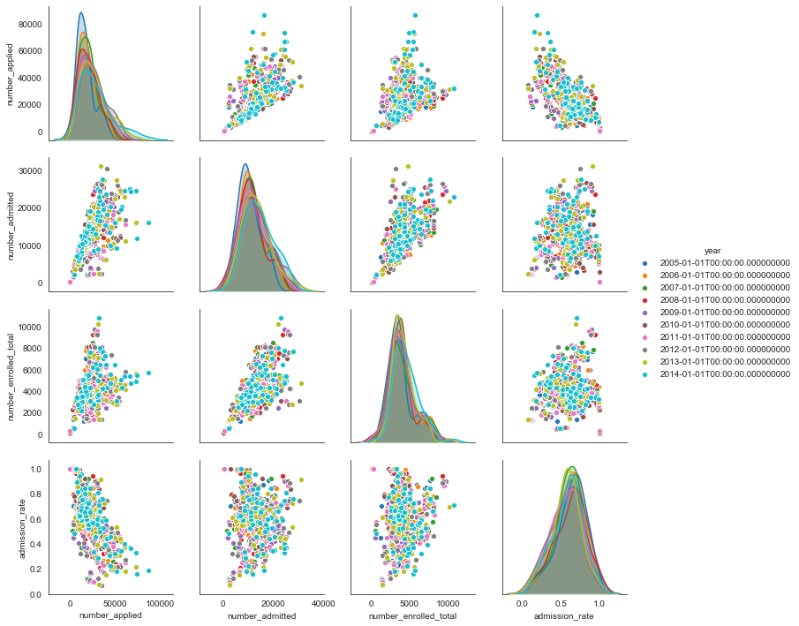
Higher-Ed: Admissions Trends
number_applied
Number_admitted
Number_enrolled_total
admission_rate
Notes:
Data wanted: Publications by university and department

Slide 8
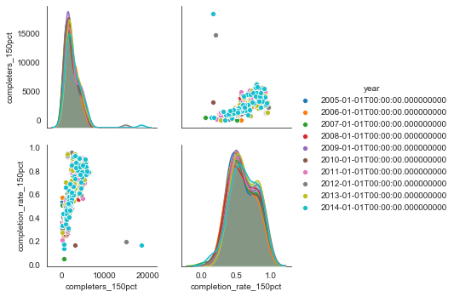
Higher-Ed: Graduation Trends
completers_150pct
completion_rate_150pct
Notes:
Data wanted: Publications by university and department

Slide 9
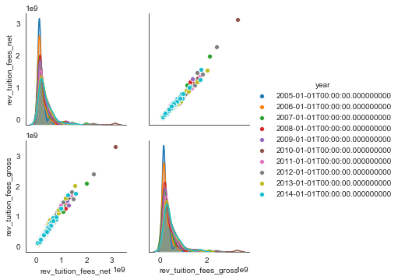
Higher-Ed: Funding Trends, Revenue Streams
rev_tuition_fees_gross
rev_tuition_fees_net
Notes:
Breakdown by “Federal”, “State”, “Local”
Then by “Appropriations”, “Grants”, “Contracts”, “Private”, “Other”
Other aggregates: rev_operating “Total operating revenue” vs nonoperating

Slide 10
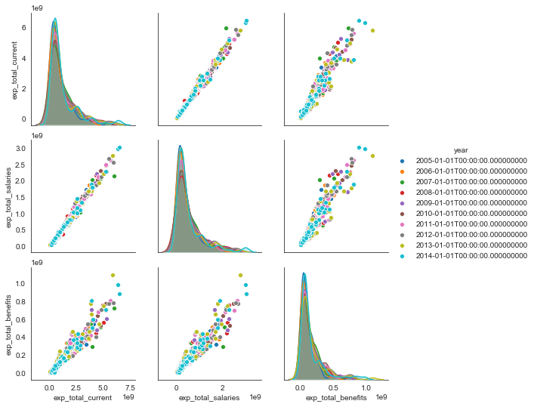
Higher-Ed: Funding Trends, Expenditures
Exp_total_current
Exp_total_salaries
Exp_total_benefits
...
Notes:
Breakdown by “Instruction”, “Research”, “Public service”

Slide 11
Proposal- Next Steps, this data set
How can I probe the cost-per-student?
How can I have confidence that my metrics of university performance are consistent with other’s rankings?
Check out published university ratings?

Slide 12
Next EDA.
Competitive Sports
Performance metrics can include:
Team’s Win-Loss ratio
Team’s social media “Likes”
Coaches’ tenure with the team
Number of postseason victories
Number of postseason appearances
Predictors to include:
Head coach salary package, annualized
Star player’s avg salary
“Normal” player’s avg salary
Star player’s # yrs in league
“Normal” player’s # yrs in league
Consider: Amateur v Pro, Men v Women
Link to starter-dataset:
NFL teams and coaches tables
<todo: get more data!>
<see ideas of where, here>

Slide 13
More EDA.
Publicly-traded companies’ CEO Compensation
Performance metrics can include:
Predictors to include:
Consider: Company size, Years in business, Industry
Link to SEC financial statements archive.
<I can locate information about executive pay in these types of filings:
a. Schedule DEF14A (annual proxy statement)
b. Form 10K (audited annual report)
c. Registration statements filed by the issuer
d. Form 8-K (current company information)>

